Slide 1

E6156-001: Topics in SW Engineering
Cloud Computing/Backend as a Service
Donald F. Ferguson dff9@Columbia.edu
TRANSCENDING DISCIPLINES, TRANSFORMING LIVES

Slide 2
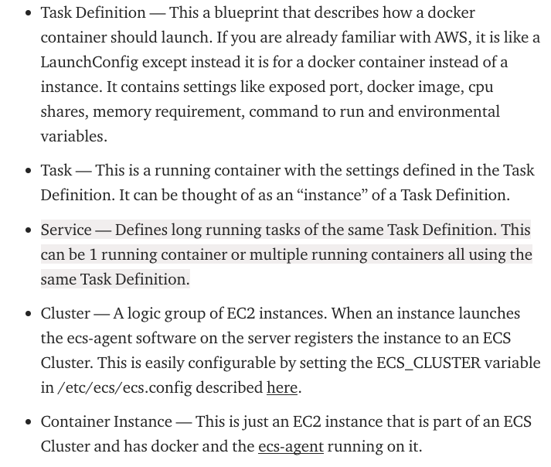
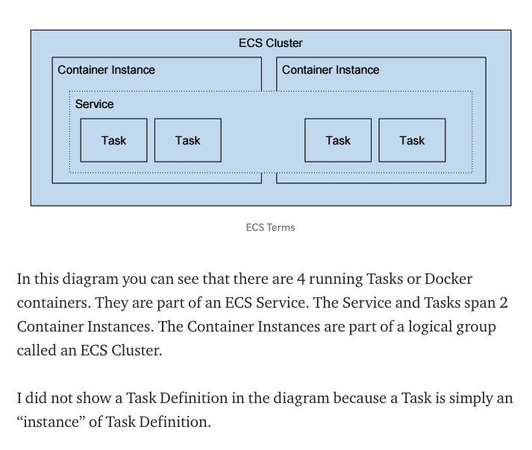
Elastic Container Service
2 | E6156: Topics in SW Engineering – Cloud Computing/BaaS

Slide 3
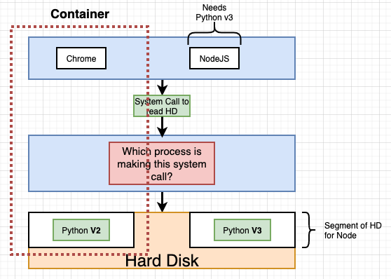
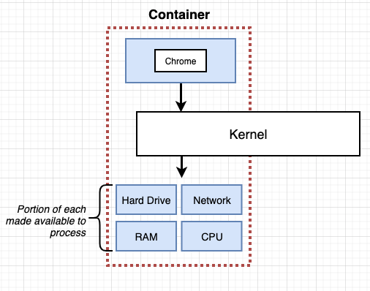
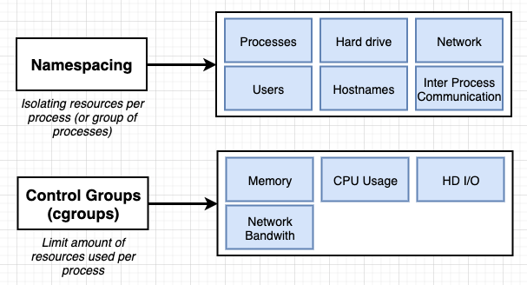
Containers and Some Docker Overview
3 | E6156: Topics in SW Engineering – Cloud Computing/BaaS

Slide 4
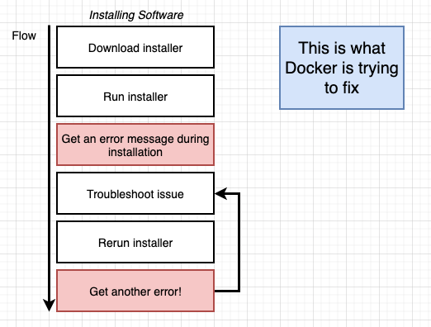
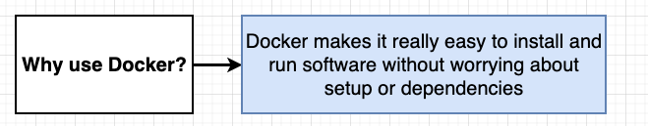
Containers and Some Docker Overview
We are familiar with the problem
We have a system with an OS and installed SW.
We need to install something new, and that requires installing prerequisites, changing versions, etc.
After many tries, we get the application installed only to find out we broke some other application.
Docker and containers allow you to:
Develop an application or SW system.
Package up the entire environment (paths, versions, libs, ...) into an image that works and is self-contained.
Someone installing/starting your application simply gets the image from a repository and starts the image to create a running container.
4 | E6156: Topics in SW Engineering – Cloud Computing/BaaS

Slide 5
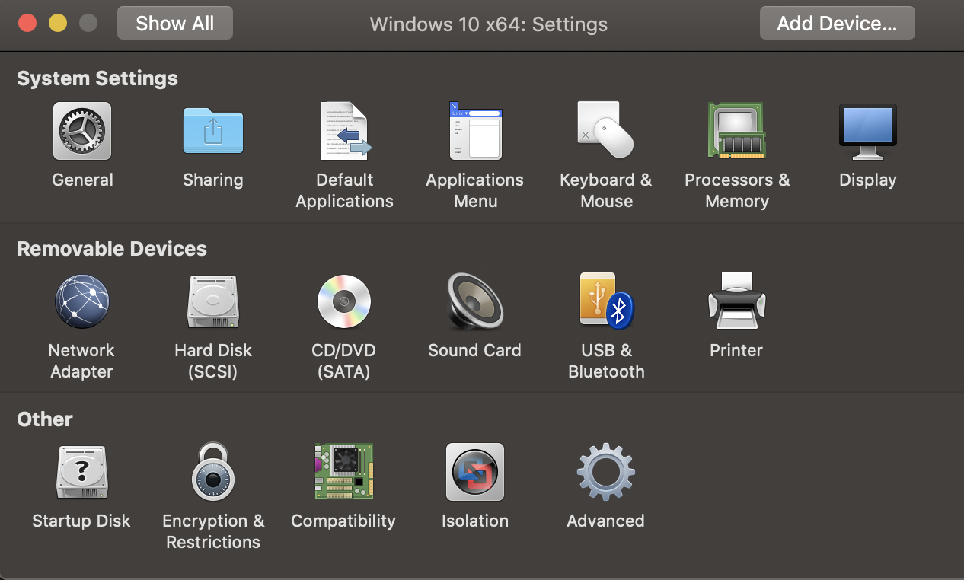
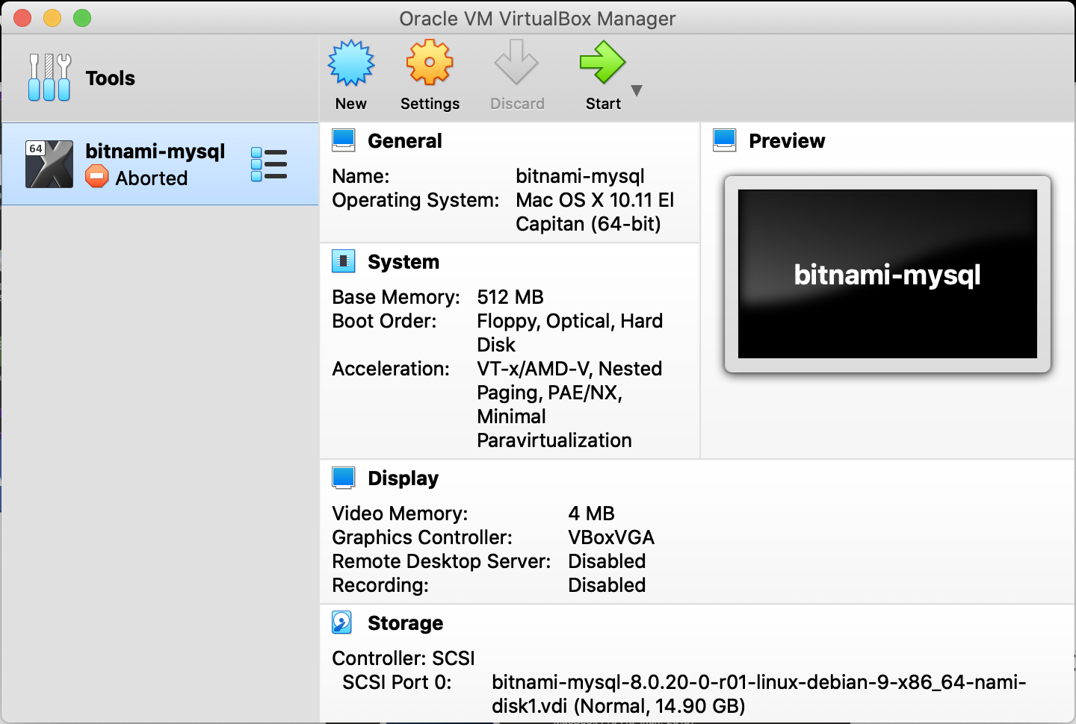
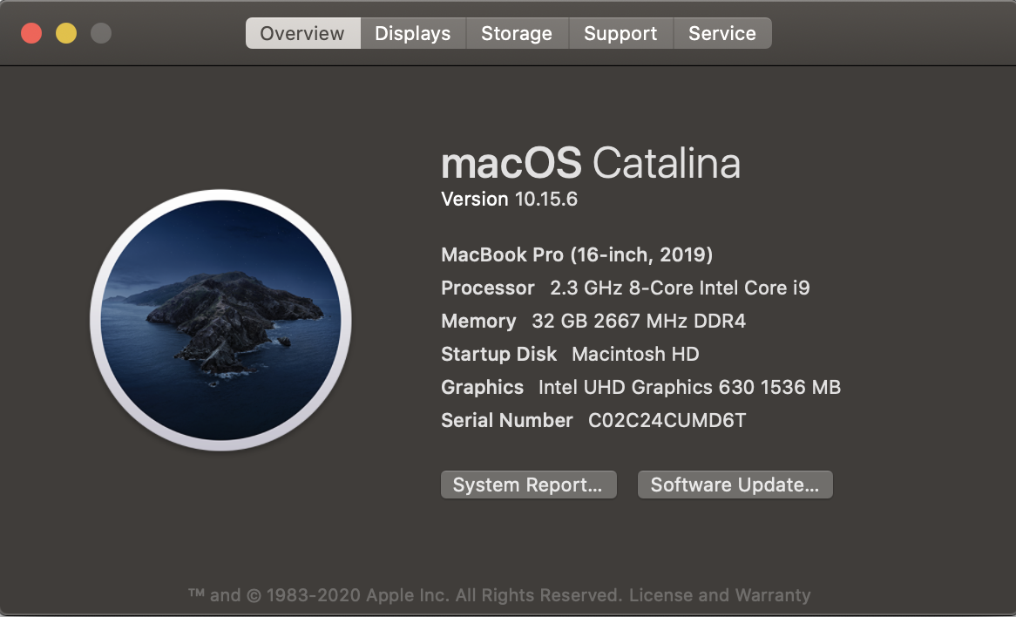
Physical Machines and Virtual Machines
VMWare Fusion
Oracle VM Virtual Box
Server, storage, network, devices
Linux Debian OS
MySQL
Two VMs:
Server, storage, network, devices.
Windows 10
My Mac with MacOS
5 | E6156: Topics in SW Engineering – Cloud Computing/BaaS

Slide 6
BaaS
Your Application Logic
Reusable Functions and Services
6 | E6156: Topics in SW Engineering – Cloud Computing/BaaS

Slide 7
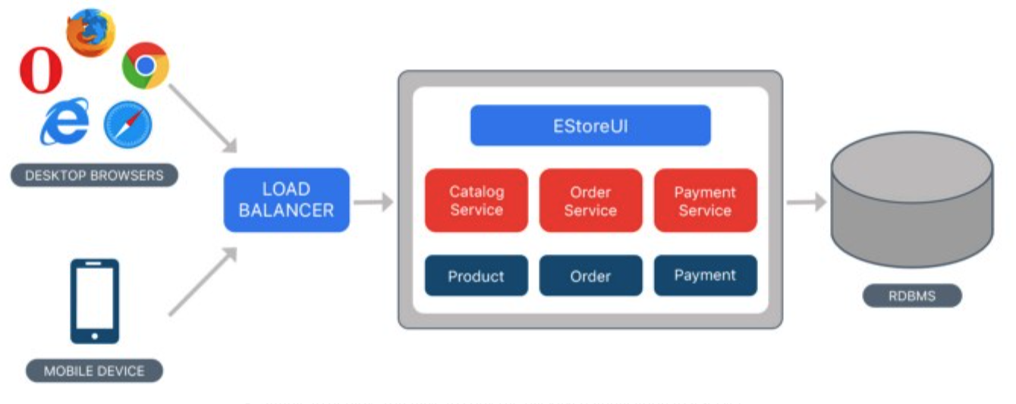
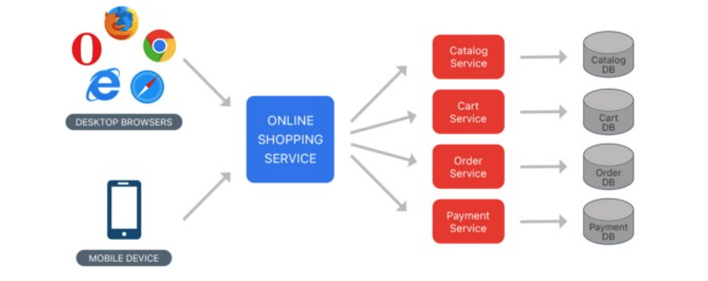
Monolithic Application → Microservices
Monolithic
May develop business functions as separate modules.
Solution “built” into single “container” using common language, ... ...
Microservice
Each business capability and technical enablement capability is a different unit (container, runtime, ... ...)
Services can choose language, database frameworks, ... ...
7 | E6156 – Topics in SW Engineering: Cloud Computing (Fall 2020)

Slide 8
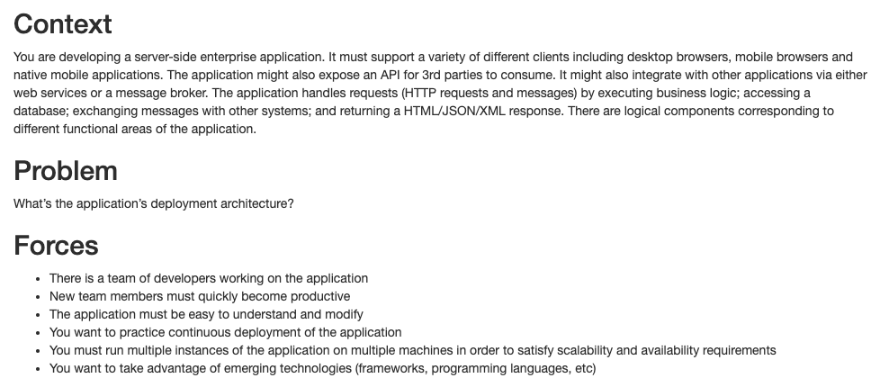
Microservices.io
https://microservices.io/patterns/microservices.html
8 | E6156 – Topics in SW Engineering: Cloud Computing (Fall 2020)

Slide 9
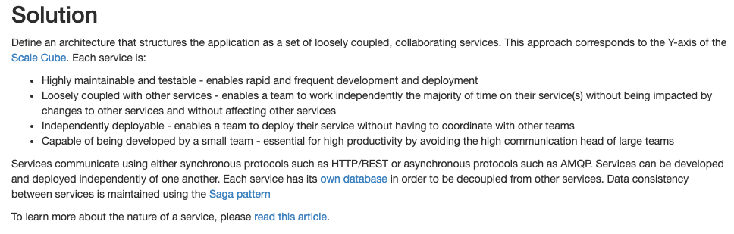
Microservices.io
https://microservices.io/patterns/microservices.html
9 | E6156 – Topics in SW Engineering: Cloud Computing (Fall 2020)

Slide 10
Microservices.io
https://microservices.io/patterns/microservices.html
10 | E6156 – Topics in SW Engineering: Cloud Computing (Fall 2020)

Slide 11
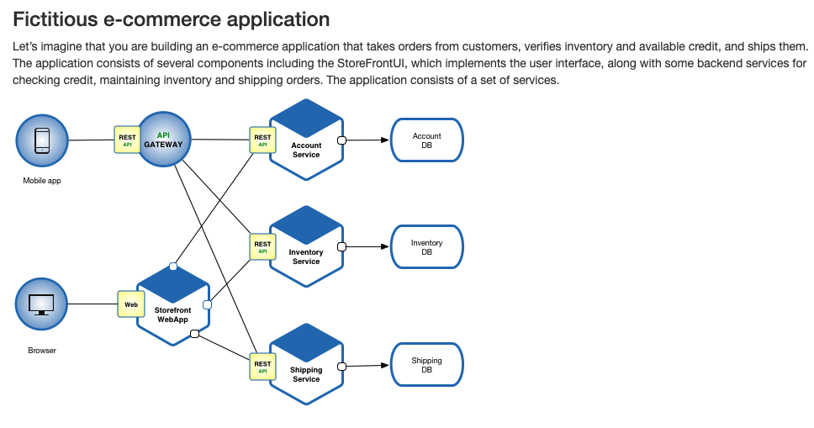
Microservices.io
https://microservices.io/patterns/microservices.html
11 | E6156 – Topics in SW Engineering: Cloud Computing (Fall 2020)

Slide 12
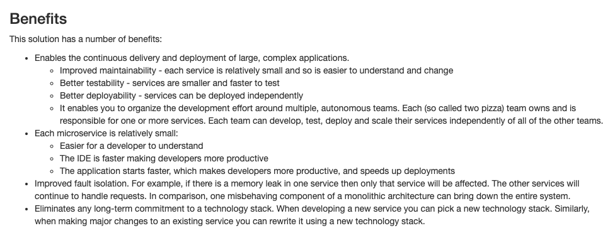
Microservices.io
https://microservices.io/patterns/microservices.html
12 | E6156 – Topics in SW Engineering: Cloud Computing (Fall 2020)

Slide 13
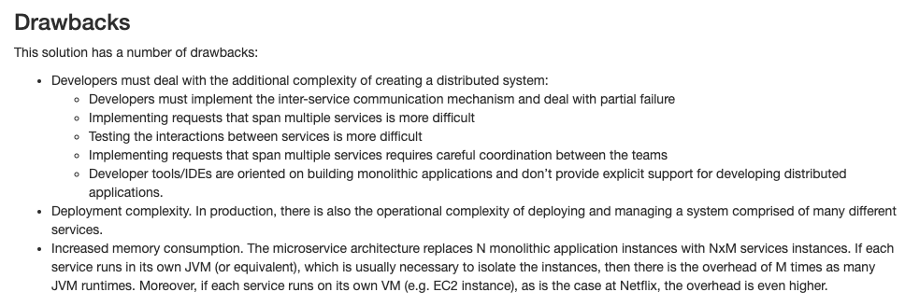
Microservices.io
https://microservices.io/patterns/microservices.html
13 | E6156 – Topics in SW Engineering: Cloud Computing (Fall 2020)

Slide 14
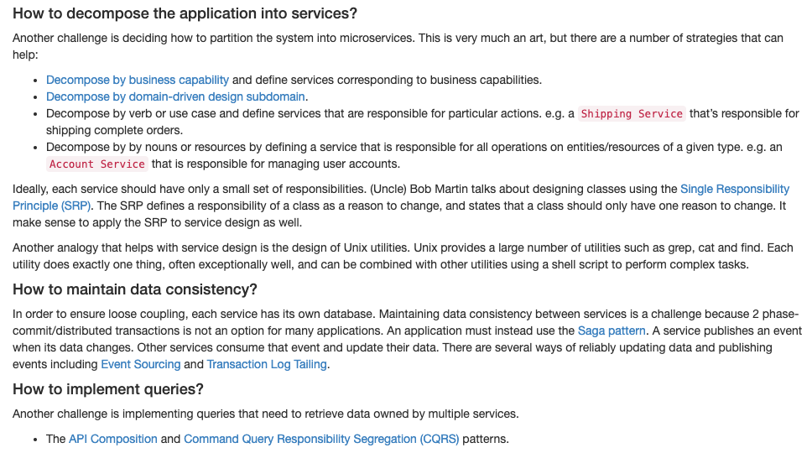
Microservices.io
https://microservices.io/patterns/microservices.html
14 | E6156 – Topics in SW Engineering: Cloud Computing (Fall 2020)

Slide 15
Variability
The “load” on an application or service is usually highly variable over time.
Think about CULPA, SSOL, CourseWorks, ... ...
Metrics:
Requests
Rate
Complexity
Sessions (”logins”):
Avg. number active.
Duration.
Session start rate.
... ...
Many factors cause variability:
Seasonal, business calendar.
Unexpected event.
Business promotion/news.
... ...
Services must:
Scale “up” to meet increased load.
Scale down to conserve resources.
15 | E6156 – Topics in SW Engineering: Cloud Computing (Fall 2020)

Slide 16
XYZ – Scalability
There are three dimensions.
A complete solution/environment typical is a mix and composition of patterns.
Application design and data access determines opitions.
16 | E6156 – Topics in SW Engineering: Cloud Computing (Fall 2020)

Slide 17
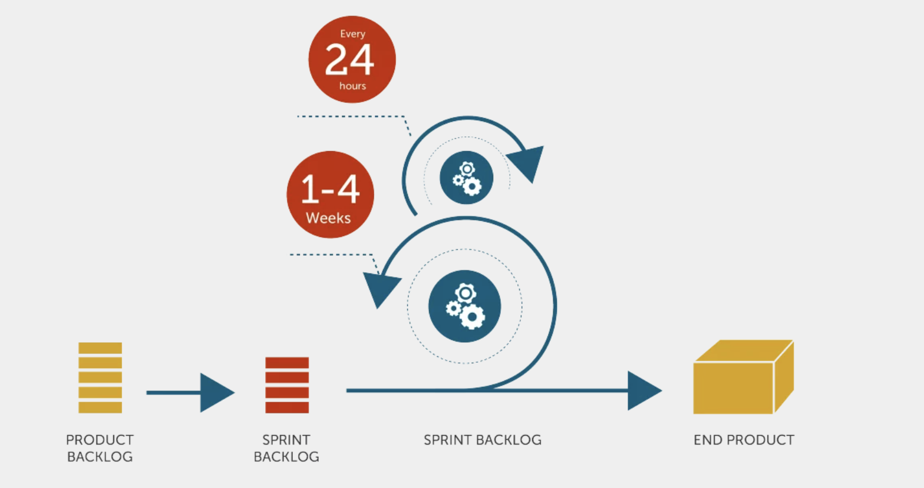
Agile Development
https://manifesto.co.uk/agile-vs-waterfall-comparing-project-management-methodologies/
My view is:
There is no “end product.”
There are sprints.
Every four or five sprints, there is a new release.
This is one of the essences of
Continuous Integration
Continuous Delivery
17 | E6156 – Topics in SW Engineering: Cloud Computing (Fall 2020)

Slide 18
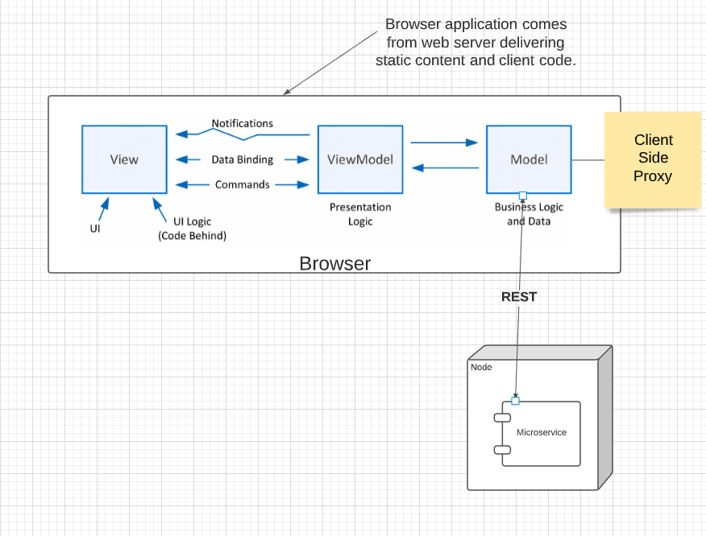
Model – View -- Viewmodel
18 | E6156 – Topics in SW Engineering: Cloud Computing (Fall 2020)

Slide 19
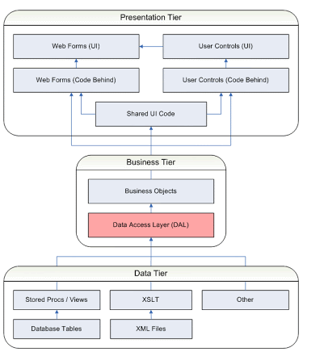
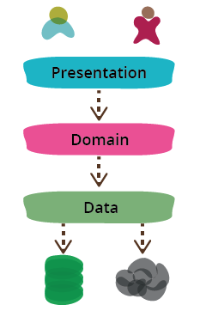
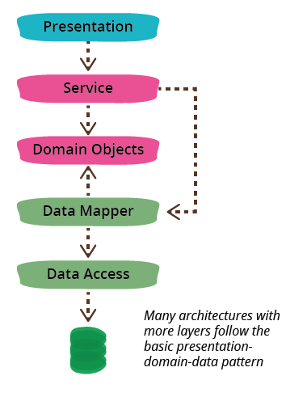
Data Access Layer
PresentationDomainDataLayering (https://martinfowler.com/bliki/PresentationDomainDataLayering.html)
https://sites.google.com/a/glenlan.com/ea/ea-domains/data-architecture/data-access-layer
19 | E6156 – Topics in SW Engineering: Cloud Computing (Fall 2020)

Slide 20

Major Divider
20 | E6156-001: Topics in SW Engineering – Cloud Computing/BaaS

Slide 21

Minor Divider
21 | E6156-001: Topics in SW Engineering – Cloud Computing/BaaS

Slide 22
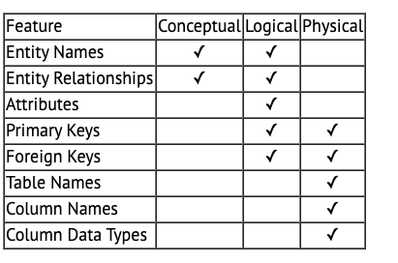
Logical – Physical – Conceptual
https://ehikioya.com/conceptual-logical-physical-database-modeling/
https://www.1keydata.com/datawarehousing/data-modeling-levels.html
It is easy to get carried away with modeling. You can spend all your time modeling and not actually build the schema.
We will use the approaches in class.
Mostly to understand concepts and patterns.
https://www.1keydata.com/datawarehousing/data-modeling-levels.html
22 | W4111_02_S20: Introduction to Databases -- Lecture 3,4

Slide 23
Crow’s Foot
I use Crow’s Foot Notation:
Simpler and more compact.
Very similar to what MySQL uses.
Less tedious, but less expressive/complete.
There is a good tutorial at ... https://www.vertabelo.com/blog/crow-s-foot-notation/
There are several other types of visual notations, and you can find examples.
I will mostly use Crow’s Foot in class, assignments, etc.
I will occasionally ask questions about the notation that the book uses on HW/exams.
What we are going to do now is ... ...
Play with two sets of tools.
Start doing a little modeling.
23 | W4111_02_F20: Introduction to Databases – Lecture 2

